Slide 1
Session 1: Business Tapas Workshop Mini-Series; Personal Brand #1

Slide 2

Malgosia Nowicka ACIM
Marketing Manager
TMC Strategic Communications
Award-winning, full-service strategic communications agency, working with clients across the Healthcare and STEM sectors to create positive impact.

Slide 3

The more people that know, like, and trust you, the easier it is to do business.

Slide 4
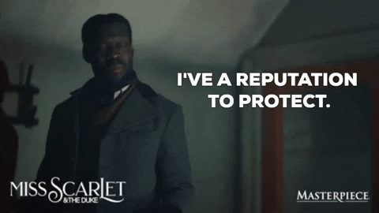

The best way to get people to like and trust you is through your own personal reputation.
Notes:
People value personal connection with the people behind a business much more than a faceless logo.
Ultimately, people will only buy from and work with people they wholeheartedly believe will get great results and serve them with integrity.

Slide 5


What is a personal brand?
Your personal brand is how you are perceived by others.
It’s the combination of your skills, values, and personality that makes you unique.

Slide 6

Your personal brand is what people think of you when you're not in the room.
- Guy Kawasaki

Slide 7
People are willing to pay up to 13.57x more for those they consider to be experts, compared to the average person.
Hinge Marketing

Slide 8
Brand messages get 561% more reach when shared through personal accounts than through the company brand account.
Hinge Marketing

Slide 9
How Will Personal Branding
Benefit You?
Take control of your reputation - your reputation is your responsibility
Grow a network of likeminded people - inspire and be inspired
Become a thought leader - become known as the expert in your field
Make the most of your expertise – share the knowledge and passion you already have
Inspire others – your post might be the push someone needs to stay motivated
Build trust and credibility - not only in yourself but in TMC too
Be an apple in a bowl of oranges - become a standout connection

Slide 10
You’ve just met someone interesting and you want to find out more about them.
What do you do?

Slide 11

Notes:
If the search results bring up outdated info, irrelevant details, negative content—or worse, you're nowhere to be found—it can really skew their perception of you and like we said earlier - first impressions matter.

Slide 12

Take control of your presence, don’t let it control you.

Slide 13
59% of people don’t have a strategy behind the content they post.
Notes:
Building a personal brand with no strategy is the same as setting out to build a house with the materials but not architectural drawing.

Slide 14
Knowing your Value & Vision
Setting your Goal
Knowing your Audience
Selecting your Channels
Polishing your Tone

Slide 15
Your elevator pitch

Slide 16
Hi, I'm Justin, and I represent FinTech Solutions Inc. We have a game-changing software that's tailored for banking systems to secure their data and streamline operations.
Our solution leverages Al-driven algorithms to provide real-time fraud detection and a seamless mobile banking interface.
We partnered with XYZ Bank 10 months ago, resulting in a 20% increase in online account openings and a 15% reduction in fraudulent transactions since.
And the best part? We never use the same parameters and configuration twice. We tailor our software to each client's needs, and the result ends up being entirely unique.
I'd love to discuss how our software can be customised to fit your bank's unique needs and goals.
Hook
Value
Evidence
Differentiator
Differentiator

Slide 17
Elevate your profile
Ensure that you have the correct company information, a suitable profile image, header image and the correct job title on your profile page. There are also other ways that you can optimise your profile to benefit your own presence.

Slide 18



Position
Amplify
Convert
Notes:
Position: Nail down what you stand for.
Amplify: Crank the volume up on your message.
Convert: Turn that buzz into opportunities.

Slide 19

Show them your value
Notes:
If you want to make your audience care and get them to pay attention, you have to position yourself as the solution to their problems. Over time, they will begin to pay more attention to you, like you, and even trust you but only as long as you continue to help them.

Slide 20

Engagement Generates Engagement

Slide 21
LinkedIn
Twitter
Instagram
Facebook
Commercial
Community

Slide 22


Slide 23
As of July 2024, there were 42.9 million LinkedIn users in the UK. A 14.4% increase from the previous month.
In June 2024, 47.1% of LinkedIn users in the UK were between the ages of 25 and 34, 21.4% between 18 and 24, and more than one in four were 35 and 54.
In February 2024, 55.6% of LinkedIn users in the UK were men and 44.4% were women.
81% of social media users in the UK are aware of LinkedIn.
The best time to post on LinkedIn in the UK is 9 AM on Tuesdays.

Slide 24
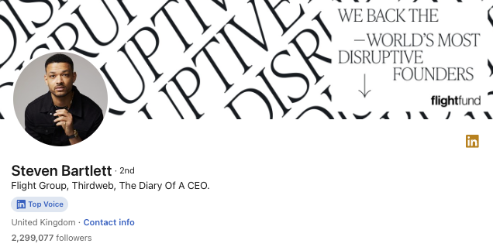
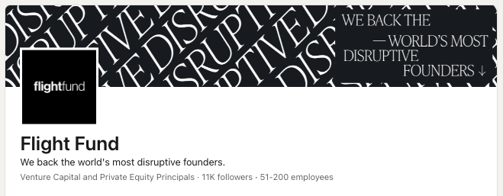
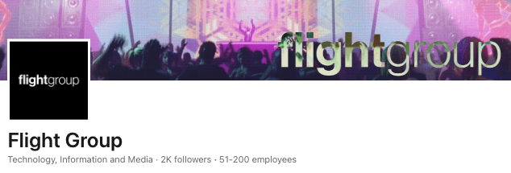

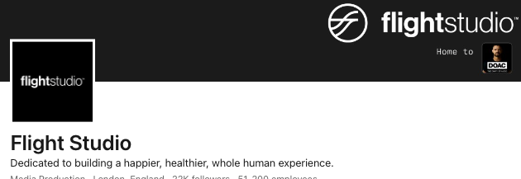
Personal Profile vs. Company Page

Slide 25






FREE
Reputation Management
Relationship Building
Audience Listening
Community Building
Tell Your Brand Story

Slide 26
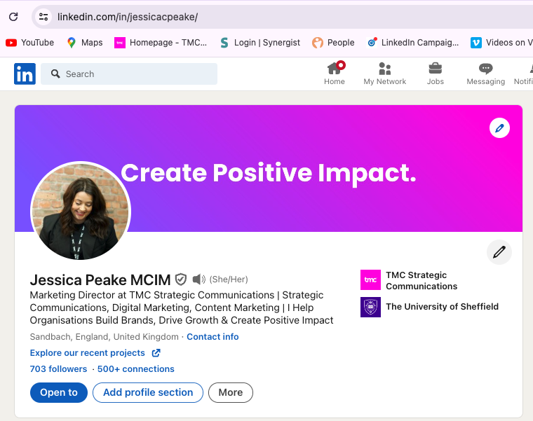
Personal Profile vs. Company Page
Create a Custom URL
Aim for a profile banner that represents your current role
Include accreditations & verification
Set up name pronunciations
Add a custom link to bio

Slide 27
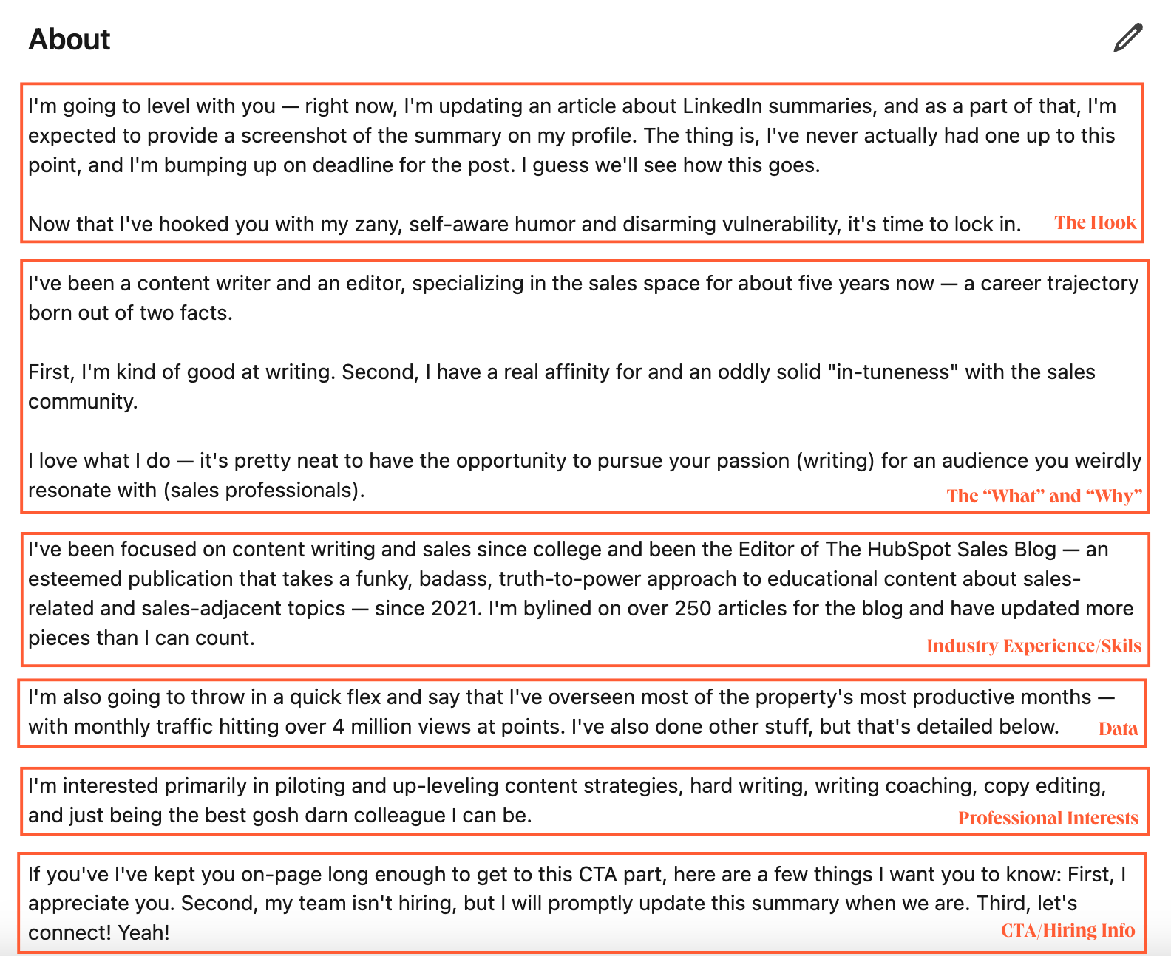
Your ‘About’ Section

Slide 28

Your ‘About’ Section
Customers need to know how [purpose you serve] — that's where I come in.
As a [role] at [company or team], it's my job to help people [purpose]. I've been doing it for [number of years in role] years and have loved every minute of it.
[Professional interest] is truly a passion for me. When I was young, I loved [related passion]. Naturally, this developed into a career in [career trajectory], which has led me to where I am today.

Slide 29


Slide 30

Mention more than just your current role
Leverage relevant keywords
Evidence your specialism

Slide 31
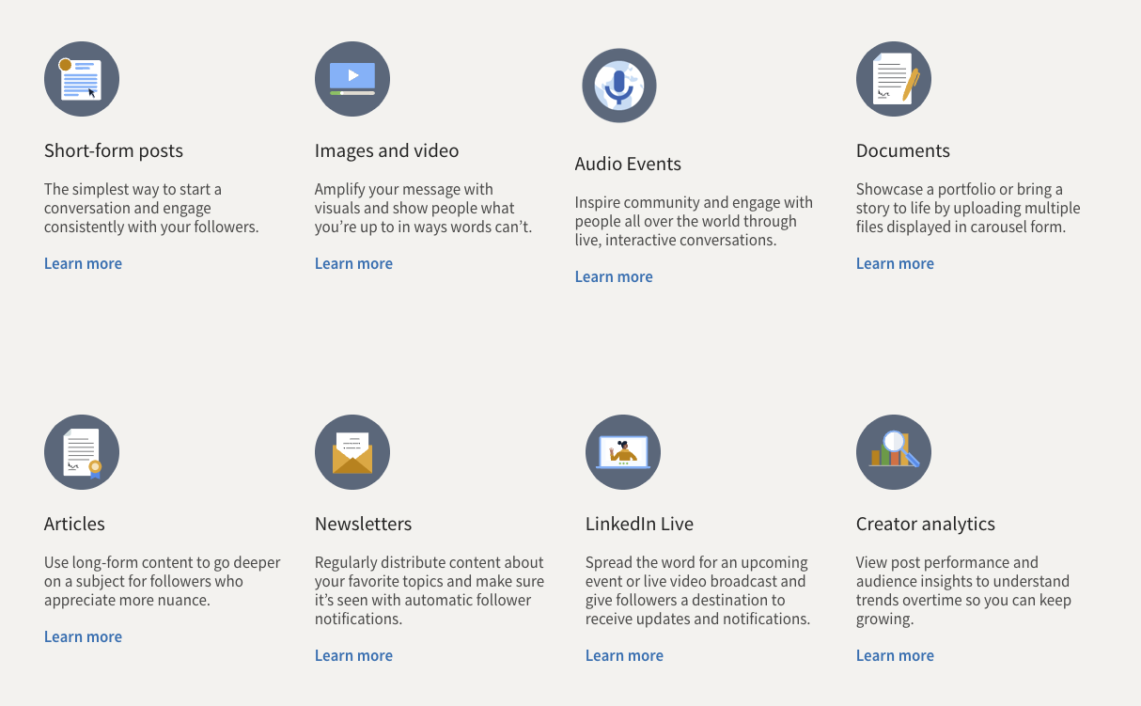
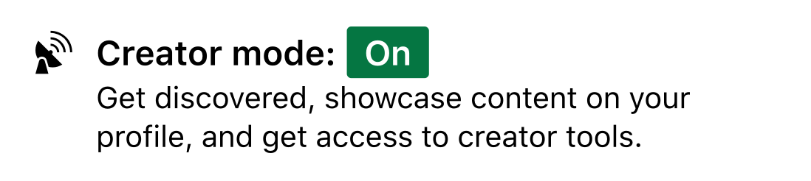

Slide 32
Each piece of content should adhere to at least one of the following:
Teach them something new - Where they learn something about your industry
Actionable advice - Practical tips your audience can use
Solve a pain - A solution to a problem they face
Testimonial - A past client explaining why your service works
Experience your personality - Creating and developing your personal brand

